Slide 1
ICRC Tableau dashboards with training data
For Athabasca University and academic use only

Slide 2
Participants survey data
Survey Monkey to Tableau

Slide 3
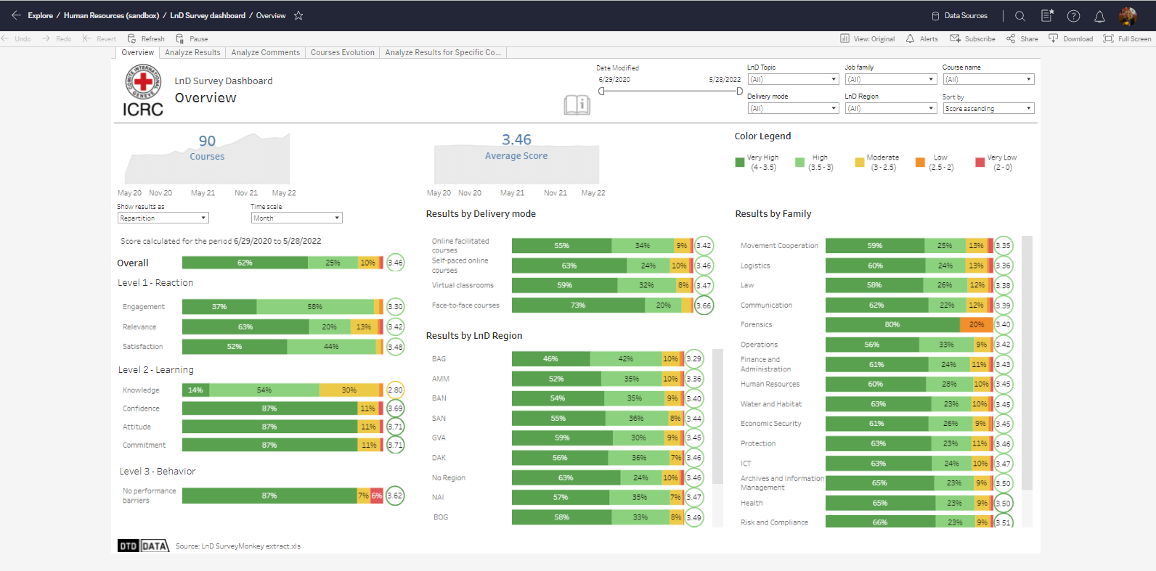

Slide 4
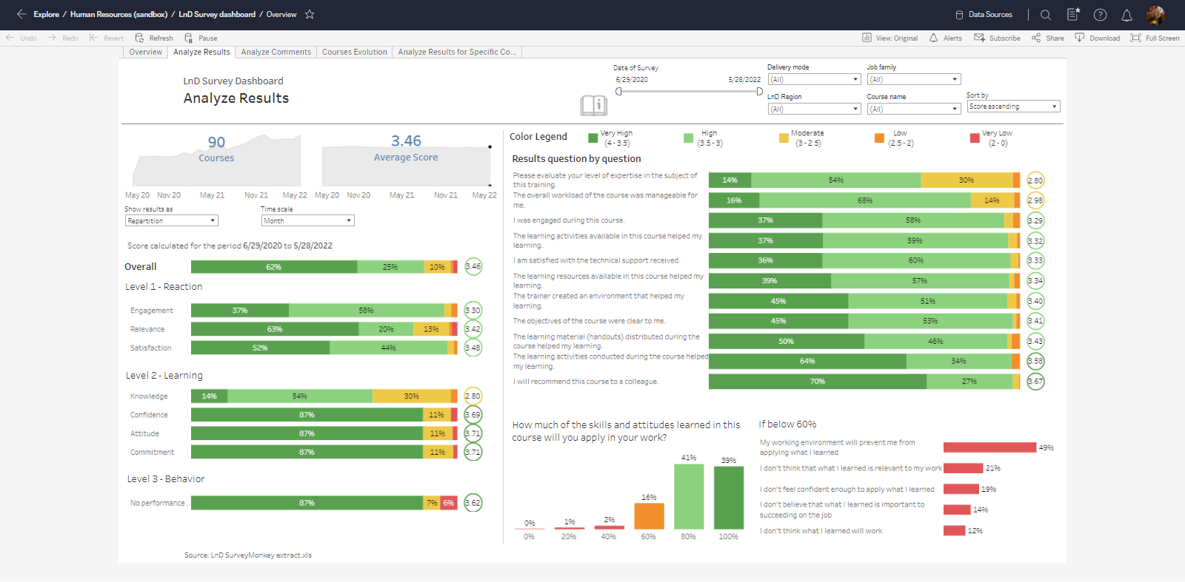

Slide 5
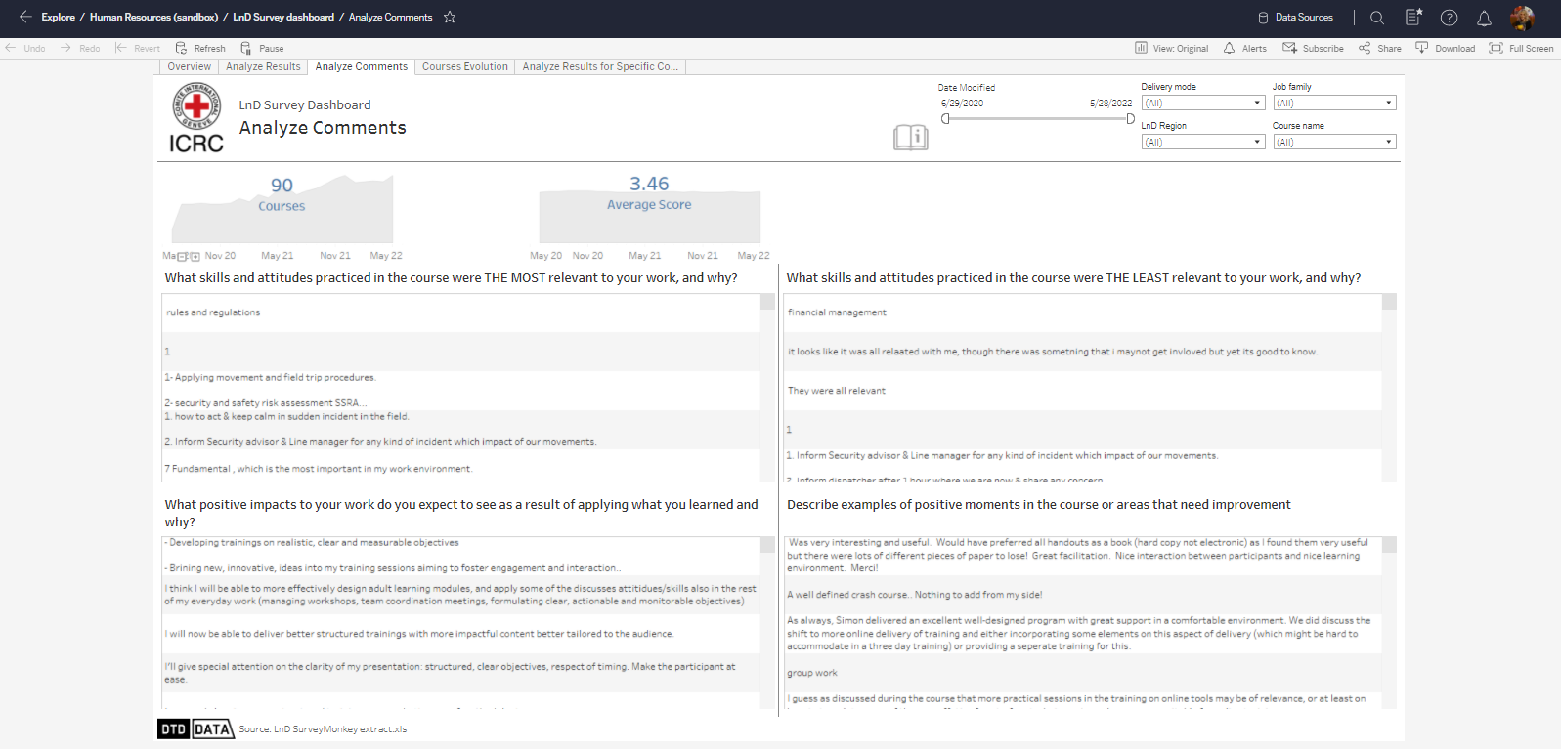

Slide 6
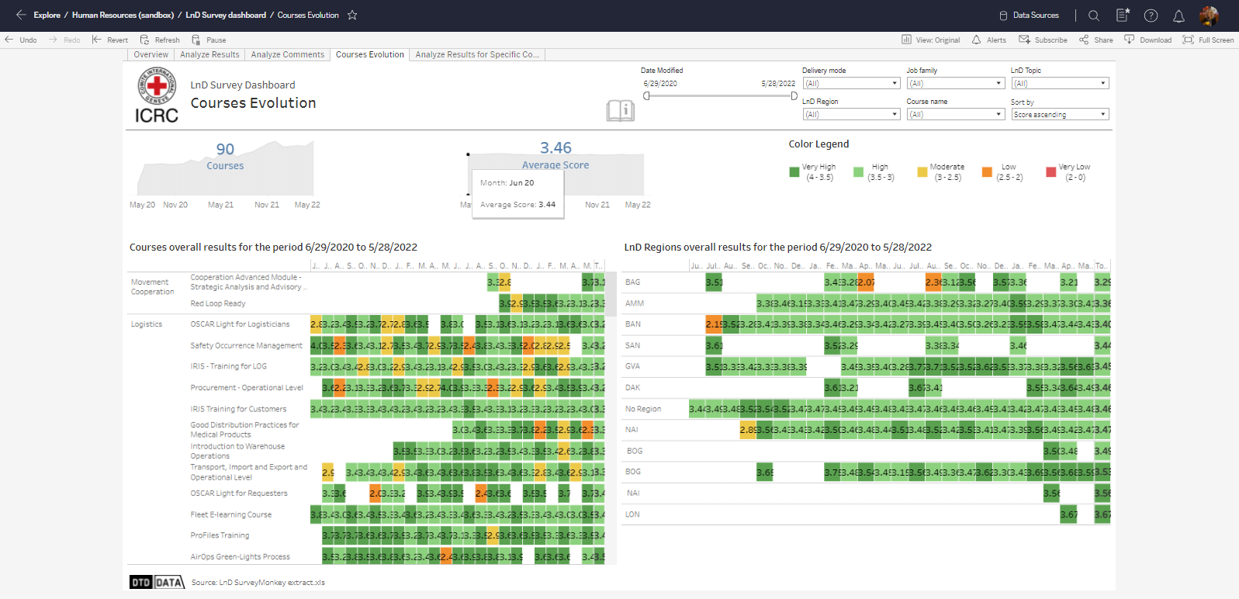

Slide 7
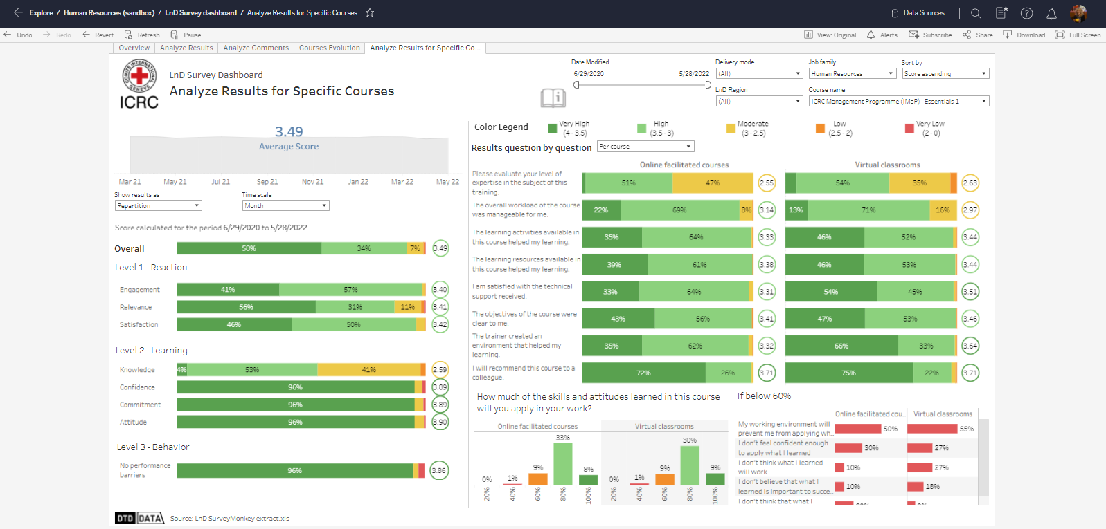

Slide 8
Course completion data
Learning Management System to Tableau

Slide 9
